Slide 1

Data Architecture for Realtime processing

Slide 2
Conceptual Diagram for data pipeline
ON-Prem
GCP
Source
Message Broker
Processing
Data
warehouse
Reports

Slide 3
Assumptions
The source databases has replication mechanism
connectivity from on prem to GCP has minimum latency
data will be stored in BIG query in star schema
dimensional model of DATA warehouse is available
Reference data management is in place and available while processing
The event will be in pipeline as and when happens generated
Reporting tool (yellowfin) is available in GCP to reduce latency

Slide 4
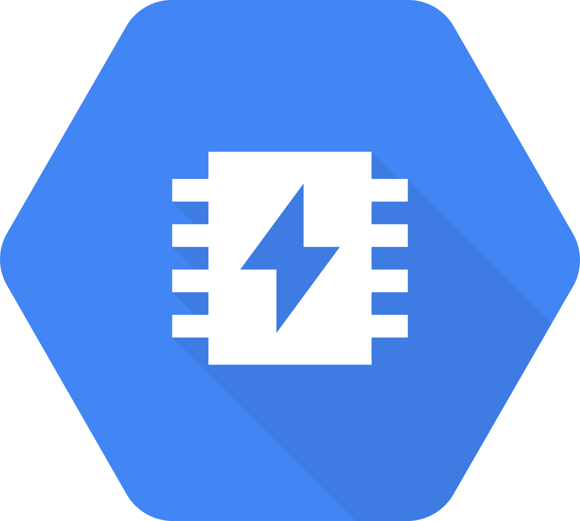





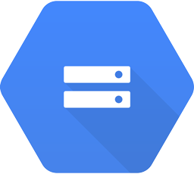
Data pipeline – component view
ON-Prem
GCP
Cloud Memorystore
Event
Cloud Pub/Sub
Cloud Dataflow
BigQuery
Cloud Storage

Slide 5

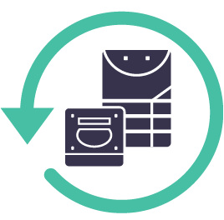
Data pipeline – component view – with peripheral services
Reference data
ON-Prem
GCP
Cloud Memorystore
Transformation
Event
Stream
binlogs
Cloud Pub/Sub
Cloud Dataflow
BigQuery
File storage
Recovery
Replay
Bug detection
Bad records
Batch Processing
Cloud Storage
Data Lineage
Logging
Monitoring
Data Archive

Slide 6

Event generation and Message broker
Event Store
Publishers
Topic 1
Subscriber
Read bin logs
Or
diff
Trigger
Timestamp
Cloud Dataflow
Topic 2
Topic 3
Event Generation Service
Cloud pubsub
Cloud Storage

Slide 7
Transform – cloud dataflow
DIM
DIM
Lookup
Cloud Memorystore
FACT
join
FACT
Cloud Pub/Sub
BigQuery
Filter
and
Denormalize
Aggregation
Surrogate key generation
Bad records

Slide 8
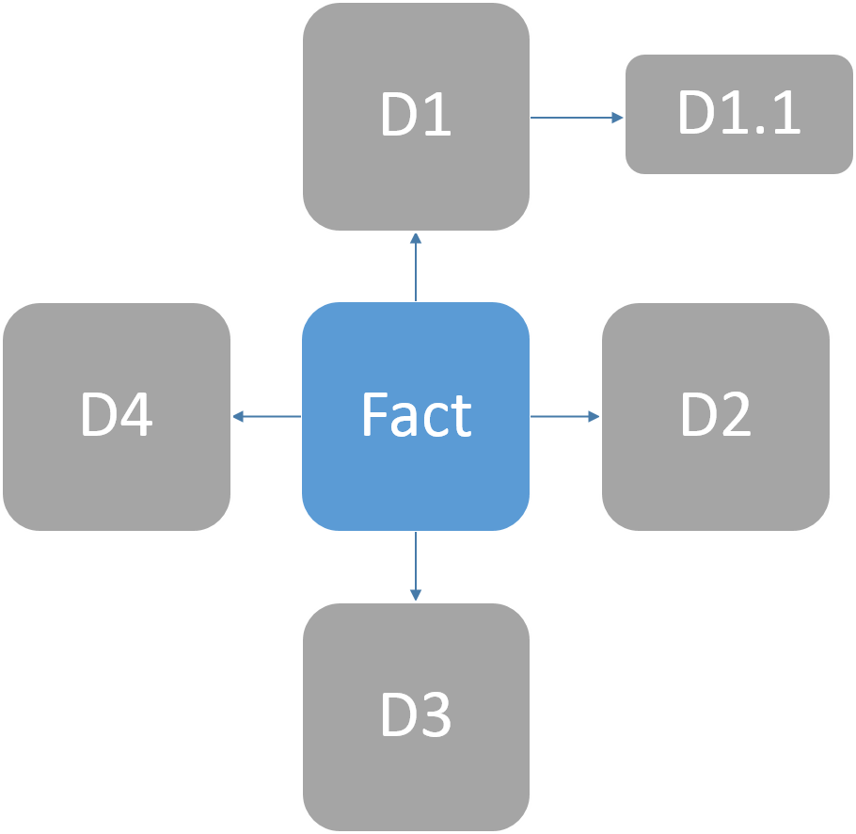
Datawarehouse – Big query
SCD 1
SCD 2
SCD 3
Slowly changing dimensions
Master table
Dimension table
Reference table
Fact table
Granularity of the table
Partition
Aggregation
Views
Row level Access control
Cost optimization
Dimension Model
Partitioning
cost reduction
Query optimization
Data purge
Archive and restore

Slide 9


